Slide 1
UNIT1: INTRODUCTION TO DATA AND DATABASES
LAGUARDIA COMMUNITY COLLEGE

Slide 2
LECTURE OVERVIEW – 5 MINS
What are Databases?
Why use a database?

Slide 3
DATABASES
Are systems that allow users to store and organize their data.
Useful when dealing with large amounts of data.

Slide 4
PEOPLE WHO USE DATABASES
Analysts
Market Research
Business
Sales
Tech
Data Scientist
Software Engineers
Web Developers
Anyone who needs data to answer a question or do something.

Slide 5
DATABASES
As a data analytics professional, you will use databases to gather your data.
Once you have access to your data source, you can begin to extract that data to answer business questions.

Slide 6

CHALLENGES OF WORKING WITH DATA…
Accessing your data from within your database.
Cleaning/transforming your data.
Accuracy of the data
What story can I tell with my data?
Is this what my users want?

Slide 7

DATA ANALYTICS
As an analytics professional, you will be working with business owners, physicians, administration, project managers, etc. …
SQL is your primary resource for finding the data needed to answer those questions.
After you have your data, you can import or connect to Python to do analysis on your data.

Slide 8
EXCEL VS. DATABASES – WHY BOTHER?
Spreadsheets
One-time Analysis
Reasonable dataset size
Ability for untrained people to work with data
Speed not that important
Databases
Can handle very large amounts of data, quickly
Quickly combine different databases
Automation
Data from websites and applications

Slide 9
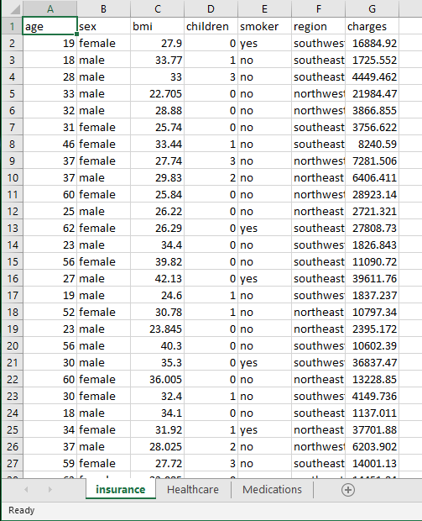
EXCEL VS. DATABASES – THEY’RE NOT THAT DIFFERENT …

Slide 10
EXCEL VS. DATABASES
Tabs = Tables

Slide 11
EXCEL VS. DATABASES
Columns

Slide 12
EXCEL VS. DATABASES
Rows

Slide 13
TYPES OF DATABASE PLATFORMS
PostgreSQL | Free - open sourced
MySQL | Free - open sourced
MS Access | Cost
MS SQL Server | Production level, found in most large organizations

Slide 14
SQL DATABASES
We will be learning about SQL – which can be applied to lots of different database platforms – so no matter what you use in your everyday job – you should be able to transfer the skills.
SQL is the programming language used for databases

Slide 15
EXAMPLE
We will be using SQL in this class. SQL is the programming language of databases.
SELECT patient_mrn, first_name, Last_name
FROM patientinfo
ORDER BY last_name;

Slide 16
WHAT TYPES OF DATA ARE THERE? 5 MINS
Discuss with your neighbor/table – what different types of data are there?

Slide 17
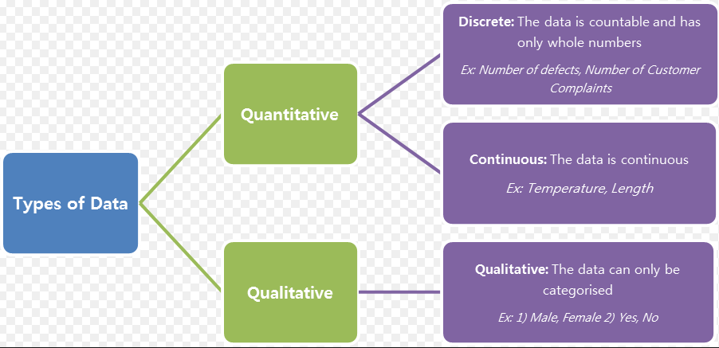
DATA TYPES

Slide 18
DATA TYPES
type | set of value | operators | sample values
int | integers | - * / % | 23, 12, 2414231
double | floating-point #s | - * . | 3.141, 2.3, 452.32
boolean | boolean values | && || ! | true, false
char | characters |  | ‘A’, ‘B’, ‘1’, ‘23’, ‘$’
strubg | seq of characters | + | “AB”, “Hello World”, “4.2”

Slide 19
RECAP
We learned
what databases are and why their used
some of the differences between excel and databases
Types of database platforms
What SQL is and an example of it
Types of Data

Slide 20

LETS CONNECT TO OUR DATABASE
PostgreSQL should already be install on your computers,
Lets work together to create our database that we’ll be working with.
This database will help show us the fundamentals of SQL.

Slide 21
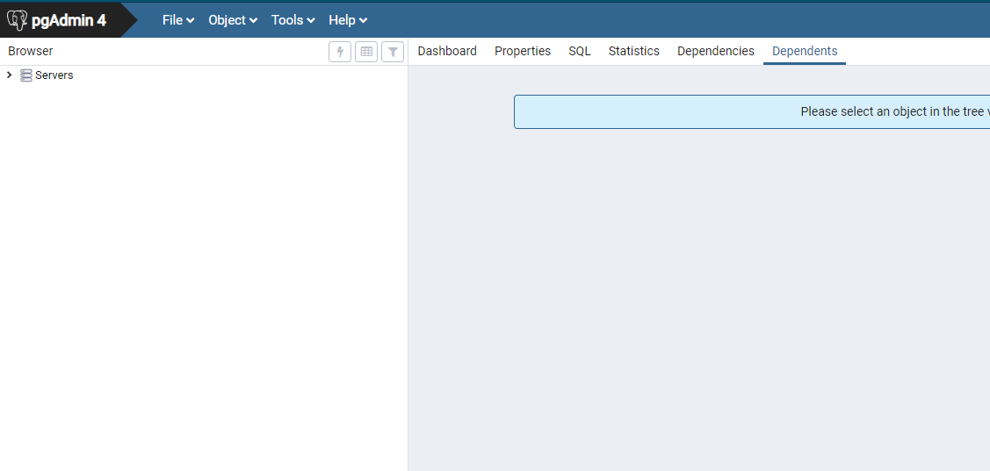
LAUNCH PGADMIN4 - POSTGRESQL
On your computer, search and launch pgAdmin4 – the application that runs PostgreSQL.
Click on the server drop down. When prompted for a password, put admin.

Slide 22
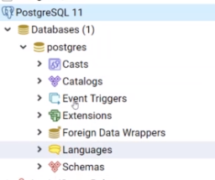
LAUNCH PGADMIN4 - POSTGRESQL
You should now see a list of your databases.
Expand the Databases dropdown, you should see a “postgres” database. IF you expand that, you should see more information regarding that database.

Slide 23
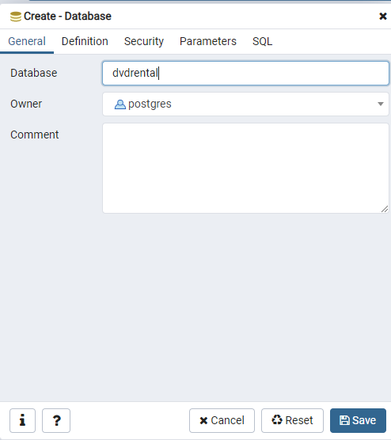
LETS CREATE OUR DATABASE
Right click on “Databases” and select “Create” > “Database”
Give your database a name – dvdrental
Hit “Save”
You should now see a new database under the Databases dropdown!

Slide 24
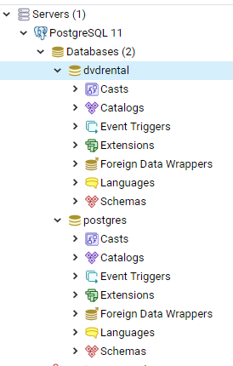
LETS CREATE OUR DATABASE
Right click on the dvdrental database
Select “Restore”

Slide 25
RESTORE DATABASE
Before we can restore our database, we need the database file!
Visit the following webpage:
https://github.com/CunyLaguardiaDataAnalytics/database_file
From here, select “Clone or Download”
Download to a folder in your documents – somewhere you’ll remember!

Slide 26
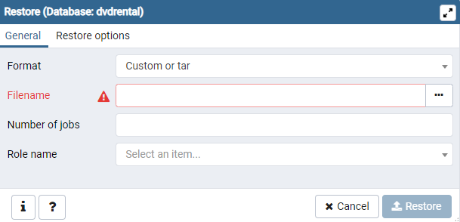
RESTORE DATABASE
Return to the restore window.
Select the Filename dropdown and search your PC for the file.

Slide 27
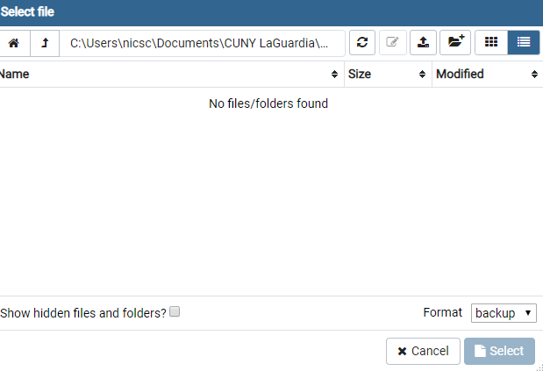
RESTORE DATABASE
You’ll notice that when you navigate to the folder that holds the dvdrental database, it’s not actually there?
Notice the dropdown on the bottom right – select it, and choose Format: “All Files”
You should now see the file!
Select it – don’t restore yet.

Slide 28
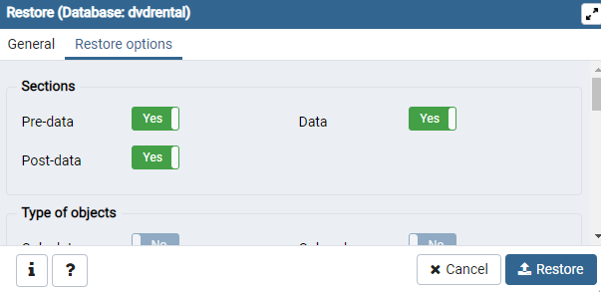
RESTORE DATABASE
Select the Restore Options tab
Change to Yes:
Pre-data
Post-data
Data
Leave all options as they are currently selected, and select Restore!
Ignore the warning message.

Slide 29
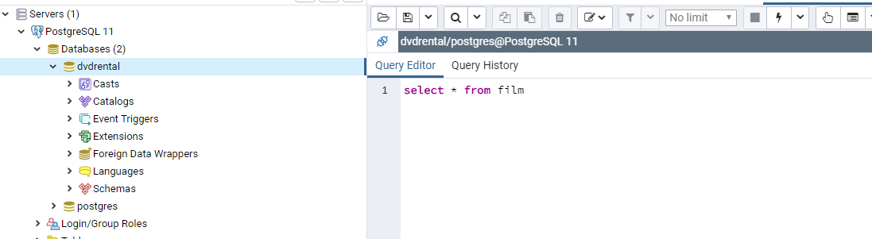
QUERY OUR DATA
Right click on the dvdrental database again, and select “Query Tool”.
Lets see if it worked properly – type:
Select * from film
If it worked – you’re all set. Explore the different drop downs (e.g. Schemas > Tables > Views)
If it didn’t work, try the steps from before again and lets do it together!

